Slide 1
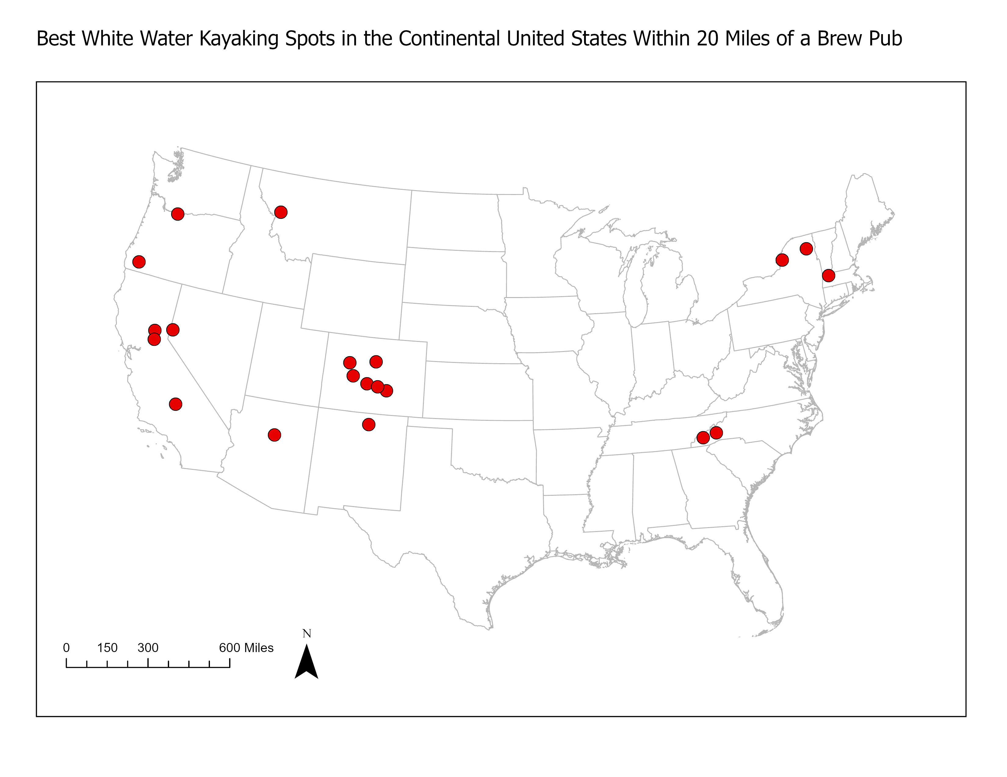
Top 57 Whitewater Towns in the United States and Canda
Introduction
Whitewater kayaking is an exhilarating way to spend your free time. Sometimes it can be hard to find the best places to get out and enjoy the rapids. It’s also nice to enjoy a microbrew after your day at a local brew pub.
This map, and accompanying list, outline the 20 best towns to enjoy your next adventure that are within 20 miles of a brew pub.
They are based on rankings and reviews from Paddling Magazine and Tripadvisor. The brew pub list comes from Open Brewery DB.
Data
The original data sets were gathered from three sources:
The Paddling Magazine article 50 Of The Best Whitewater Towns To Visit before You Die.
Tripadvisor 20 Amazing White Water Rafting Trips In The USA.
Open Brewery DB
All files are saved on GitHub
Figure 1: Locations of the 20 top whitewater towns in the Continental United States Within 20 Miles of a Brew Pub.
Results
Conclusion
There are a total of 41 top rated towns for whitewater in the Continental United States.
Of those 41 towns, 20 have a brew pub withing 20 miles of their location.
This is a link to the 20 Best Whitewater Towns in the Continental US Withing 20 Miles of a Brew Pub.
An important factor associated with enjoying your next whitewater adventure is to find the best places to run the rapids.
Another thing to consider is where you want to grab a good beer and a meal afterwards.
These sources have outlined the best towns to take your adventure to the next level and enjoy a microbrew after your day playing in the river.
Enjoy this “best of” list when planning your next whitewater trip.
Citation: Jeremy Johnson(2025), “Top 57 Whitewater Towns in the United States and Canada”. GitHub, https://github.com/jeremybjohnson/GIS-Geocoding
Methods
A table of data was created using the locations for whitewater towns from the two data sources. This table included ranking and category where available
A buffer analysis was performed against all brew pubs listed in Open Brewery DB within 20 miles of one of these whitewater kayaking towns.
The plot shows the 20 whitewater kayaking towns with a brew pub withing 20 miles.
Author: Jeremy Johnson, Houston City College
GISC 1411 - Geographic Information Systems, Fall 2025

